Slide 1





NTI - AI
Hotel Booking Cancellation Prediction
Hotel Signals
Supervised by: Eng. Fady Attia

Slide 2



NTI - AI
Problem Definition
Hotel booking cancellations create uncertainty in hotel operations, leading to empty rooms, revenue loss, and inefficient resource planning.
Project Goals
Build accurate models to identify bookings that are likely to be cancelled
Evaluate different algorithms to find the best-performing model.
Understand key factors that influence cancellations and suggest actionable recommendations.

Slide 3

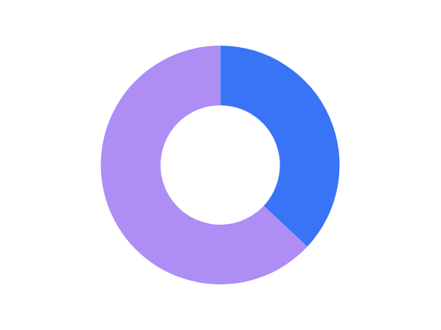
NTI - AI
Dataset Overveiw
199,390 Records
33 Features
Target Variable:
is_canceled(yes/no)
Cancellation Rate: 37%

Slide 4

NTI - AI
Data Cleaning
129,425 Missing Values
0 Duplicated Rows
Bookings with zero total guests were removed
Missing Values: Identified and handled missing data across columns such as children, country, agent, and company

Slide 5
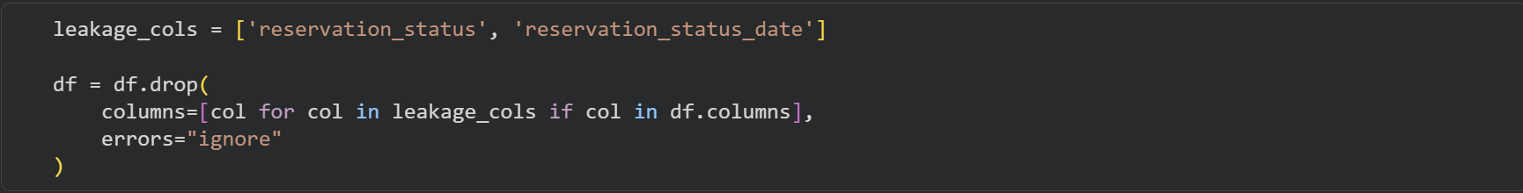
NTI - AI
Data Cleaning
Duplicates: Checked the dataset for duplicate records and found no duplicate bookings.
Data Leakage: Removed reservation_status and reservation_status_date because they could reveal information about the booking outcome.

Slide 6

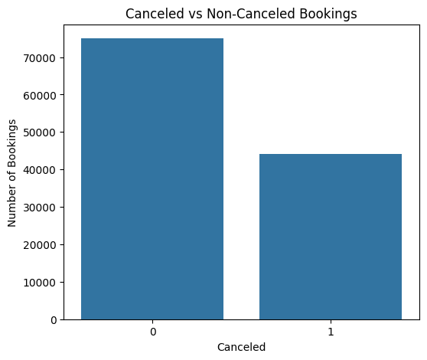
NTI - AI
Exploratory Data Analysis
Canceled vs Non-Canceled Bookings
Non-canceled bookings represent about 62.9% of all bookings, while canceled bookings account for about 37.1%, showing that cancellation is a substantial part of the dataset.

Slide 7
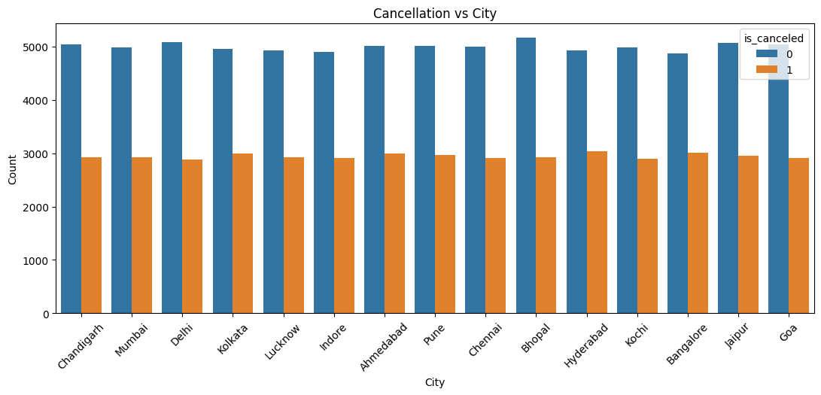
NTI - AI
Exploratory Data Analysis
Cancellation vs City
Booking volume varies slightly across cities, but every city shows a considerable number of cancellations alongside successful bookings.

Slide 8
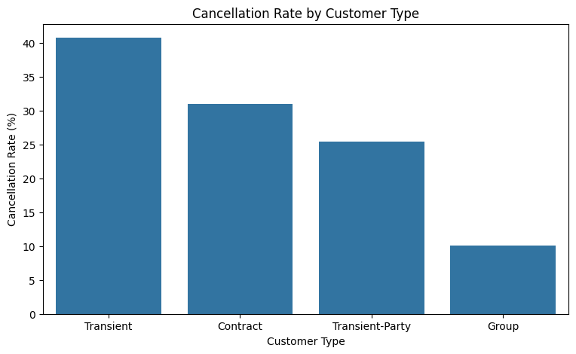
NTI - AI
Exploratory Data Analysis
Cancellation Rate by Customer Type
Cancellation behavior differs across customer types, showing that some customer groups are more likely to cancel than others even when their total booking volumes are smaller.

Slide 9
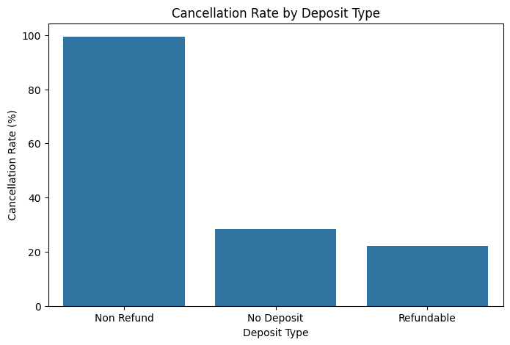
NTI - AI
Exploratory Data Analysis
Cancellation Rate by Deposit Type
Deposit type shows a strong relationship with cancellation, with Non-Refund bookings having an exceptionally high cancellation rate compared with the other deposit categories.

Slide 10
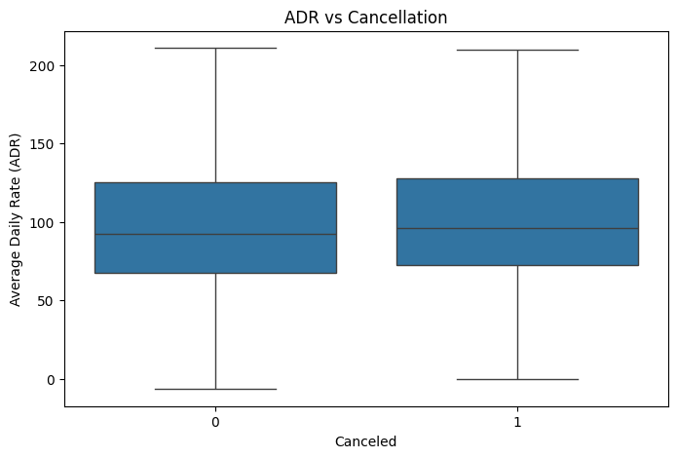
NTI - AI
Exploratory Data Analysis
ADR vs Cancellation
The central ADR distributions of canceled and non-canceled bookings are relatively similar, suggesting that ADR alone does not strongly distinguish between the two groups.

Slide 11
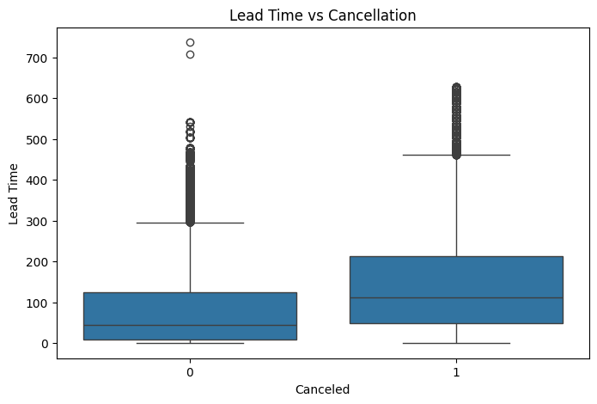
NTI - AI
ExploratoryData Analysis
Lead Time vs Cancellation
Lead time is strongly right-skewed, meaning most bookings are made relatively close to arrival while only a small number are made many months in advance.

Slide 12
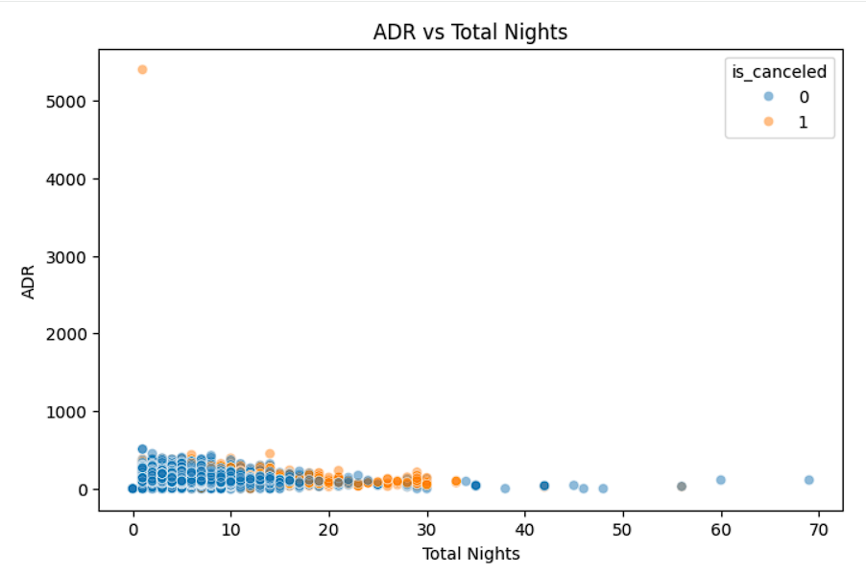
NTI - AI
ExploratoryData Analysis
Total Nights vs ADR
This visualization make us know that :
ADR and total stay nights show no strong relationship, with most bookings concentrated around short stays and moderate ADR values.

Slide 13
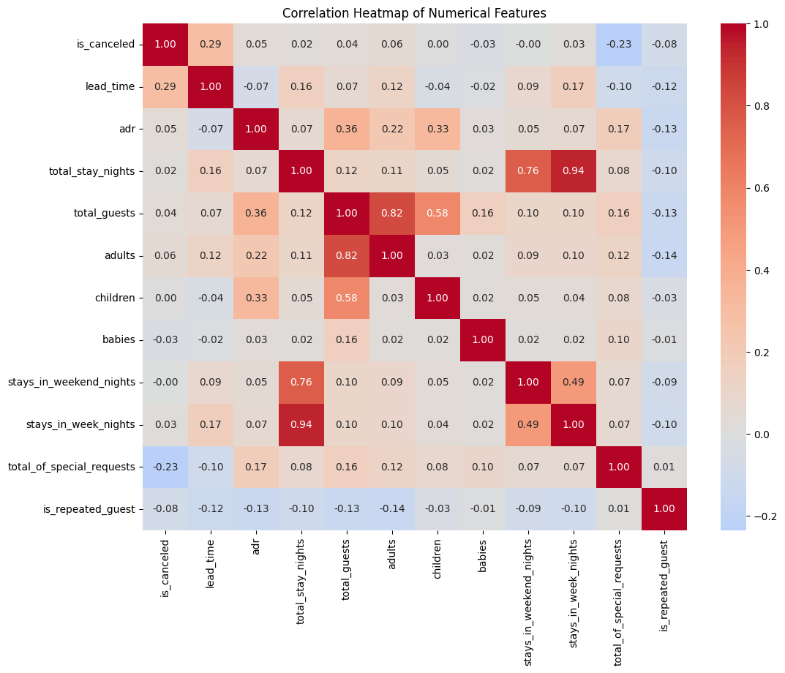
NTI - AI
Exploratory Data Analysis
Correlation Heatmap of Numerical Feature
correlation heatmap shows the strength and direction of relationships between numerical variables and helps identify features that may have useful associations with booking cancellation.

Slide 14

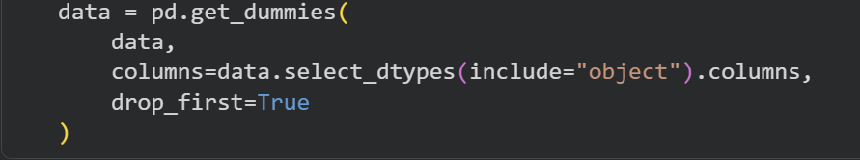
NTI - AI
Data Preprocessing
Feature Engineering
Categorical Encoding
Data
Splitting
Scaling
Feature Engineering: Created total_guests by combining adults, children, and babies.
Converted categorical variables into numerical features using get_dummies.

Slide 15
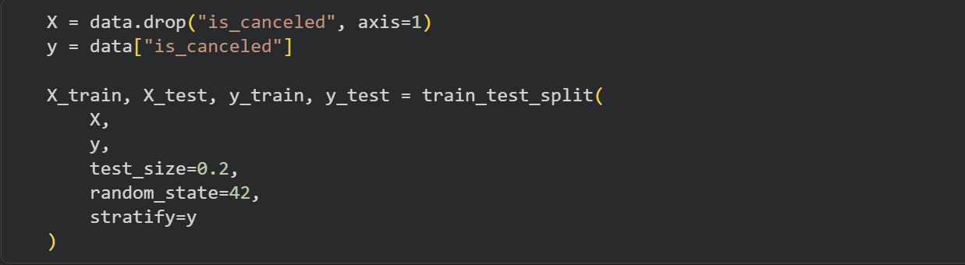
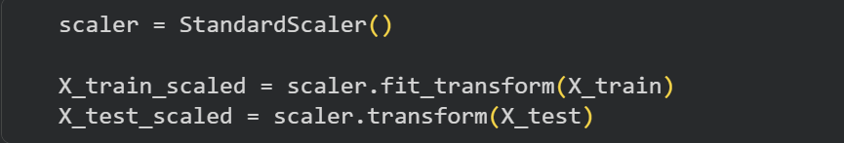
NTI - AI
Data Preprocessing
Data splitting: Divided the dataset into 80% training data and 20% testing data.
Feature Scaling: Standardized numerical features to bring them to a similar scale

Slide 16

NTI - AI
Classification Models
In the Hotel Booking dataset:whether a hotel booking will be canceled or not canceled using is_canceled.
Logistic
Regression
Decision Tree
Random Forest
Gradient Boosting
KNN
XGBoost

Slide 17
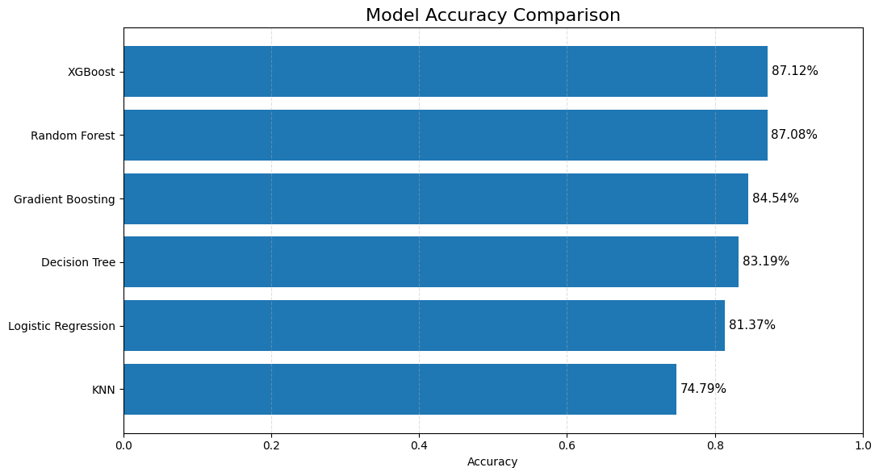
NTI - AI
Classification Models evaluation
XGBoost: Achieved 87.12% accuracy, 85.00% precision, 79.23% recall, and the highest F1-score of 82.01%.

Slide 18
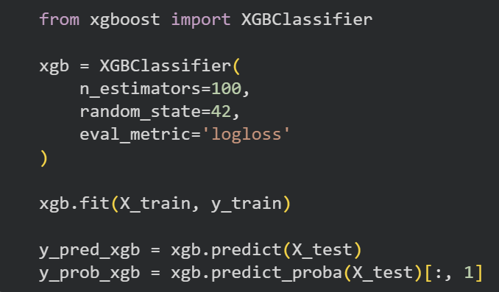
NTI - AI
Classification Models
XGBoost
Why XGBoost:
XGBoost is a powerful boosting algorithm that combines multiple decision trees to make accurate predictions.
Feature Importance: XGBoost feature importance was used to identify the features that contributed most to the cancellation predictions.

Slide 19
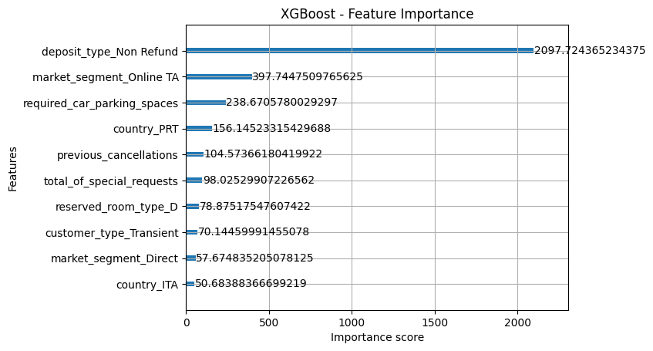
NTI - AI
Classification Models evaluation
Top Predictor: deposit_type_Non-Refund has the strongest influence on the XGBoost cancellation predictions.

Slide 20

NTI - AI
Regression models
In the Hotel Booking dataset:It can be used to predict a numerical value such as the Average Daily Rate (adr) based on the booking information.
Linear Regression
Decision Tree Regression
Random Forest Regression
Gradient Boosting Regression

Slide 21
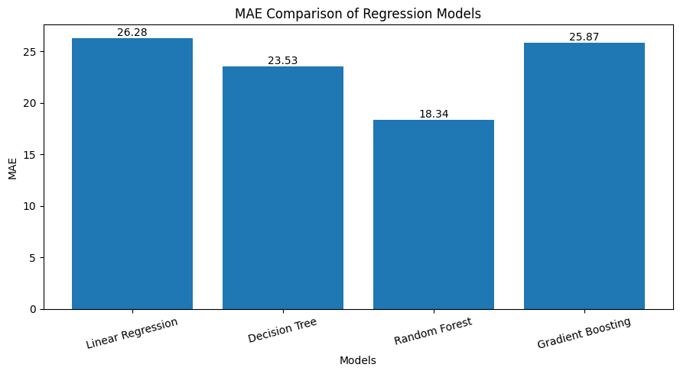
NTI - AI
Regression models Evaluation
Random Forest achieved an R² of 0.414, with an MAE of 18.34 and an RMSE of 45.11, making it the strongest model among the evaluated regression models.”

Slide 22
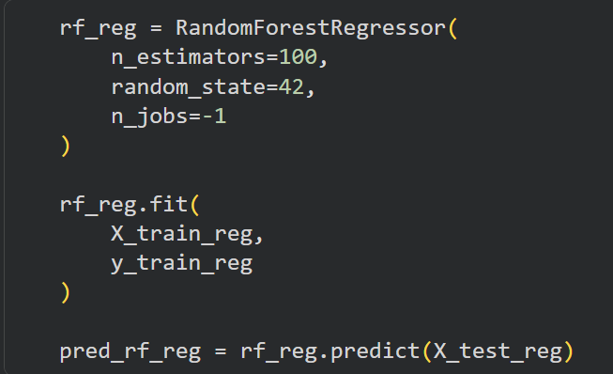
NTI - AI
Regression models
Random Forest
We used ADR : as our target variable. We separated ADR from the input features and removed records with negative ADR values because they are invalid for hotel pricing.
Why Random Forest : combines multiple decision trees to improve prediction,capture non-linear relationships between booking features.

Slide 23
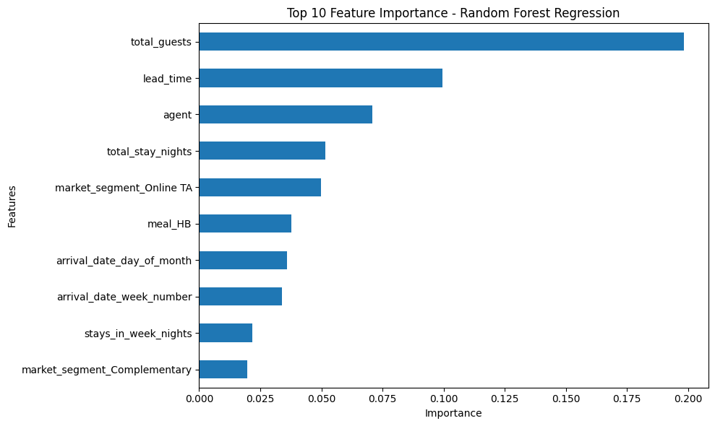
NTI - AI
Regression models Evaluation
Top Predictor: Total guests has the highest impact on ADR prediction, followed by lead time and agent.

Slide 24

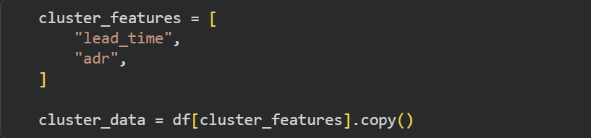
Nti-project
Clustering model (K-Means)
In the Hotel Booking dataset: It can be used to discover different groups of bookings/customers based on characteristics such as lead time, ADR
Why k-Means: Simple and easy to implement for customer segmentation.
The dataset contains numerical features suitable for distance-based clustering.
Preparing data for clustering

Slide 25
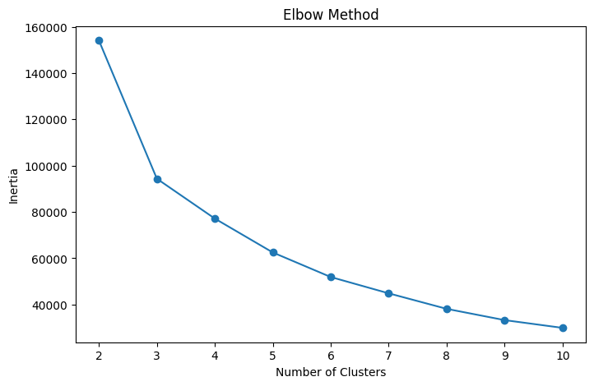
NTI - AI
Clustering model (K-Means)
Elbow Method:
The Elbow Method suggested K = 3 as a possible cluster point, but the result was not definitive.

Slide 26
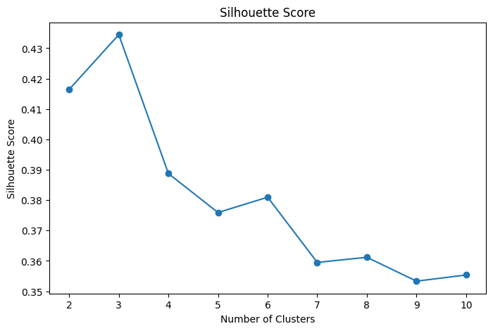
NTI - AI
Clustering model (K-Means)
Silhouette Score :
The Silhouette Score reached its highest value at K = 3, supporting K = 3 for the final model.

Slide 27
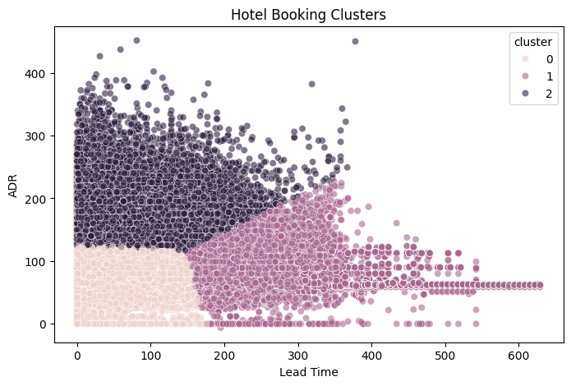
NTI - AI
Clustering model (K-Means)
K-Means divided the bookings into three clusters based on ADR and lead time. The clusters represent different booking patterns, such as lower-priced bookings, higher-priced bookings, and bookings with high lead time.

Slide 28

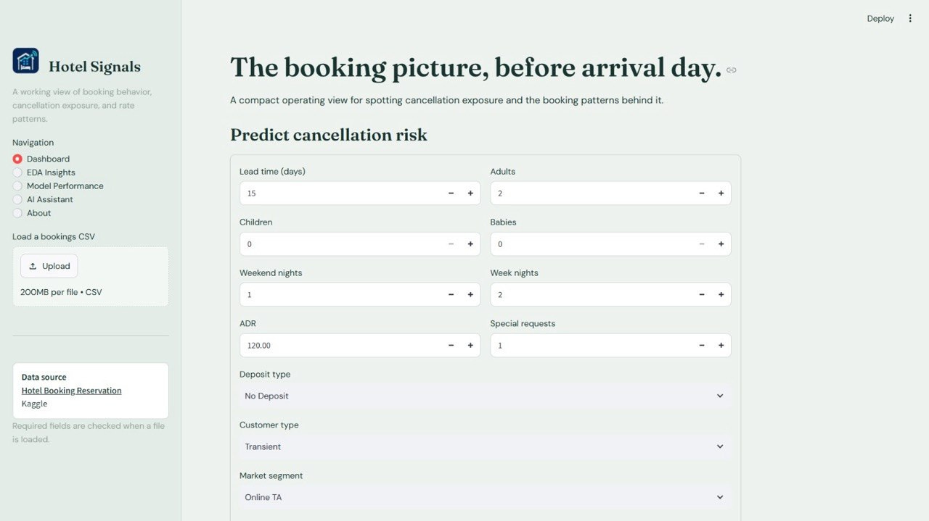
NTI - AI
Streamlit GUI

Slide 29
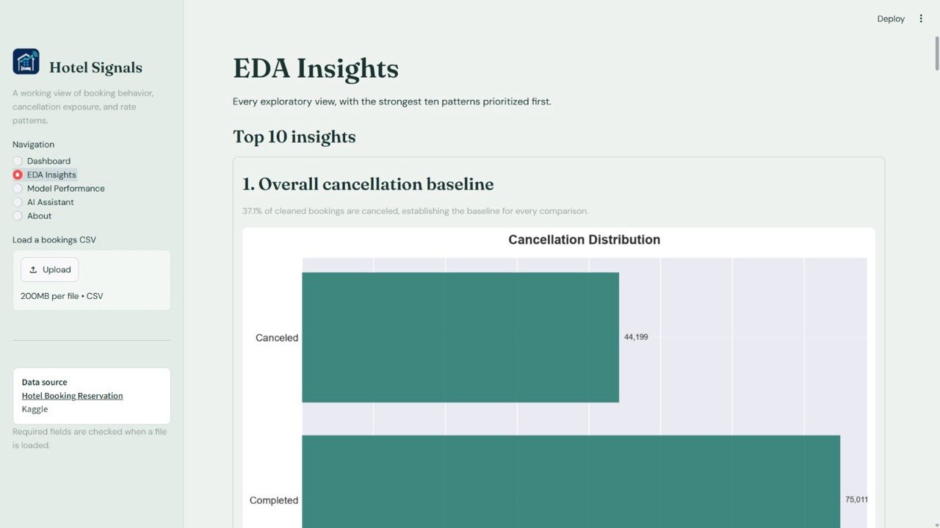
NTI - AI
Streamlit GUI

Slide 30
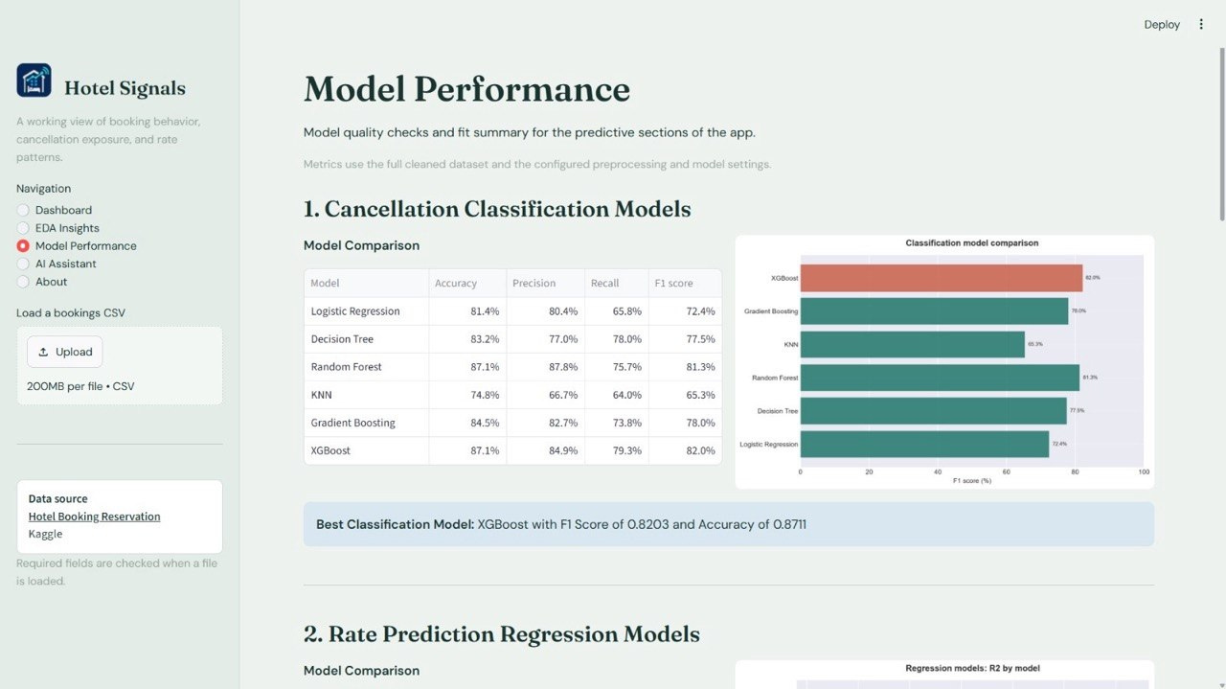
NTI - AI
Streamlit GUI

Slide 31
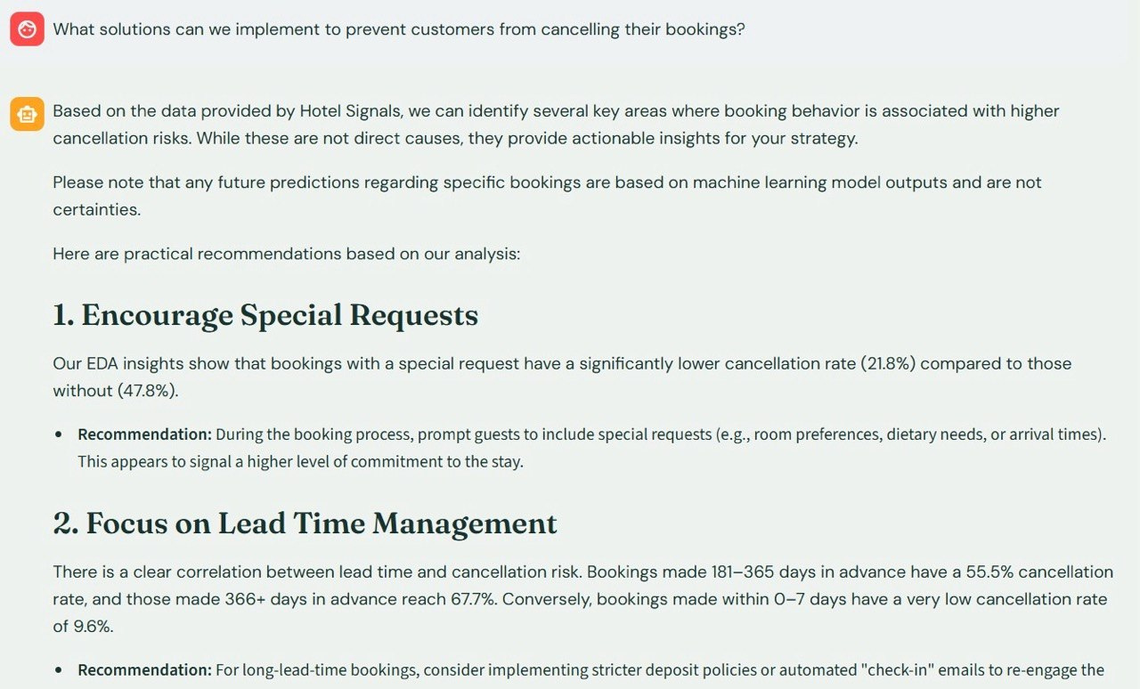
NTI - AI
Streamlit GUI

Slide 32
NTI - AI
Thank You!
Presented by :
Rawan Ibrahim
Nada Mostafa
Salwa Hisham
Nafe Emad
Nour Eldin Yasser
Supervised by: Eng. Fady Atia

